Slide 1
Thermal Modeling Works
Dongmyung Suh

Slide 2
Thermal CFD Analysis: Liquid Cooling Battery Package

Slide 3
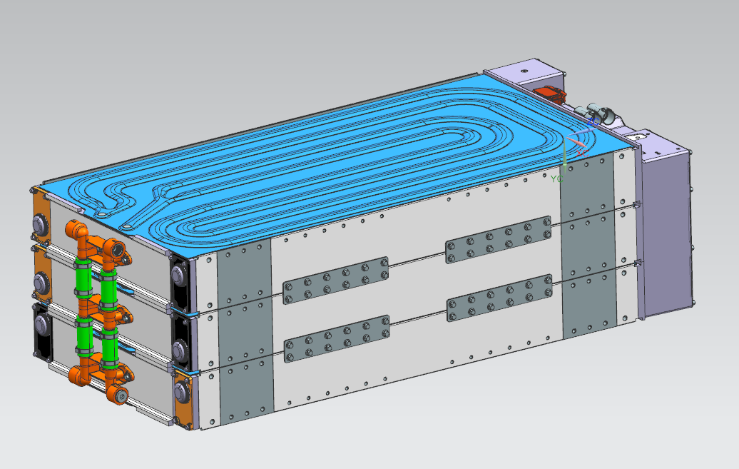
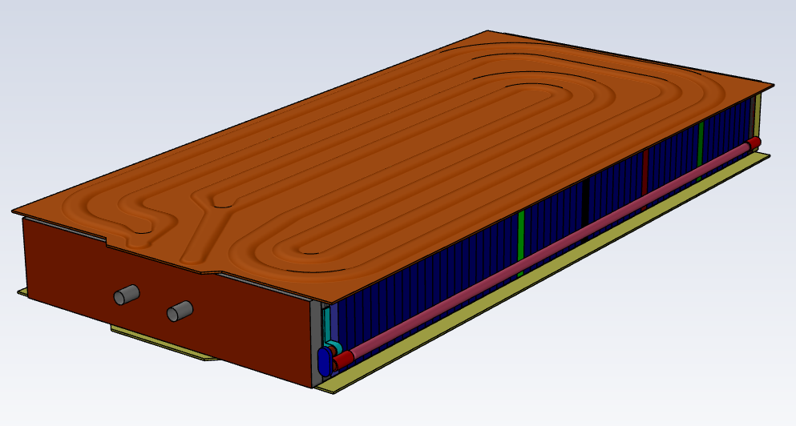
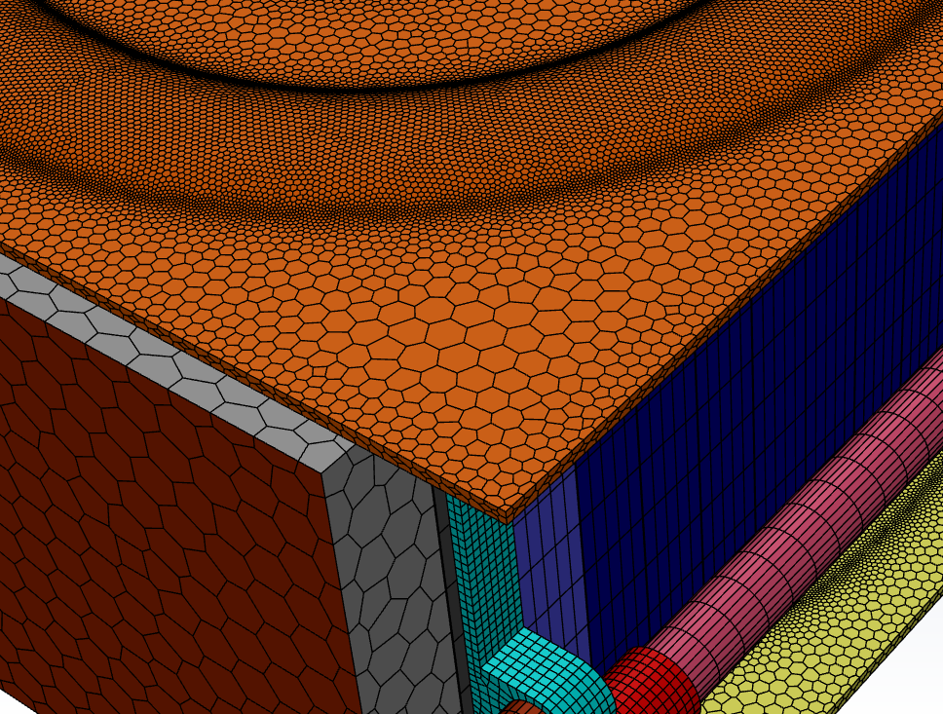
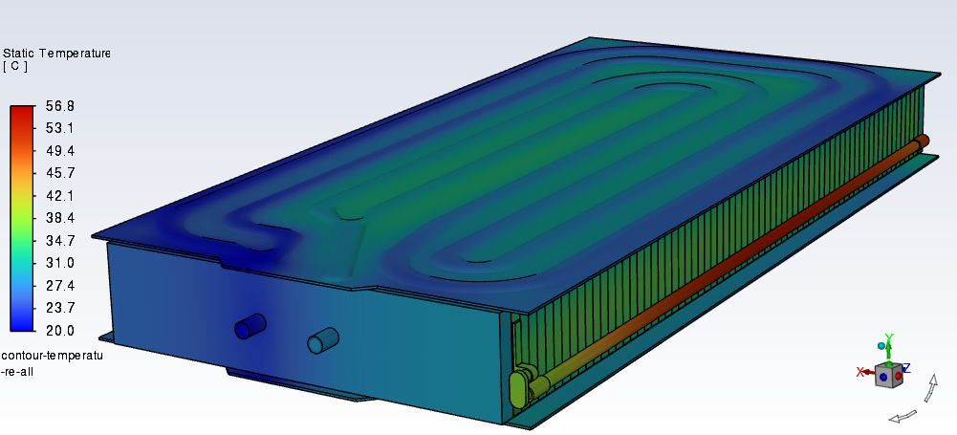

Thermal CFD Analysis: Liquid Cooling Battery Package
Cold-Plates for cooling cells
76 cells are connected
ATLAS(104kWh) Battery Package
Coolant in/outlet
Total 20 million meshes
Battery Pack Module
Thermal Analysis: Temperature distribution

Slide 4

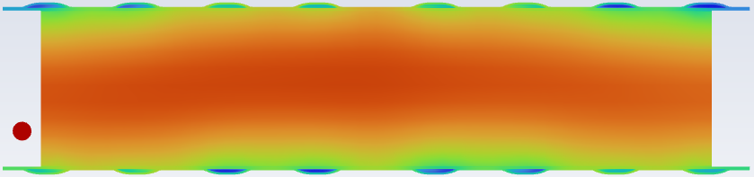
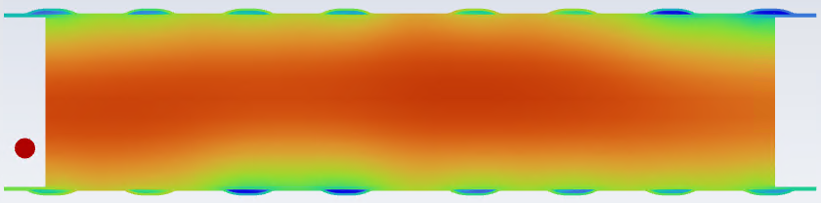

Cell67
Cell47
Cell27
Cell 01
Cell 47
Cell01
Cell 27
Cell 67
Thermal Analysis: Temperature distribution
Temperature Distribution of Cells

Slide 5
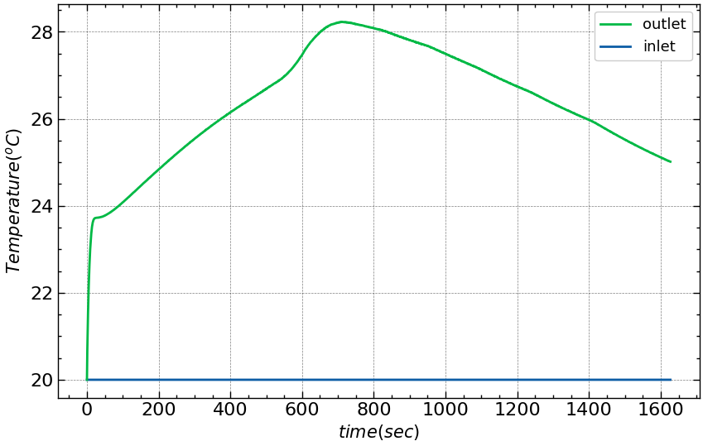
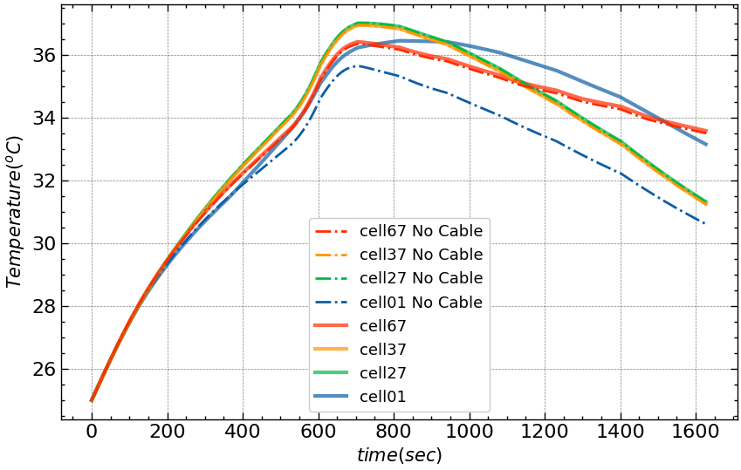
Transient Thermal Behavior
Coolant Temperature Evolution
Max. Temperature in Each Cell

Slide 6
Thermal System Modeling: HVAC of a vehicle Cabin

Slide 7
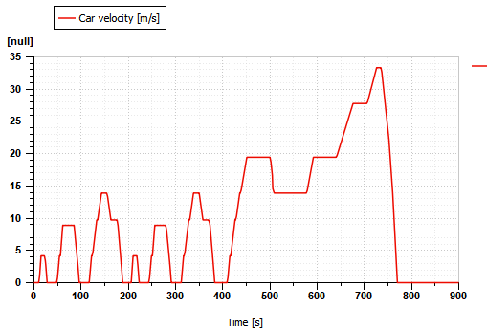
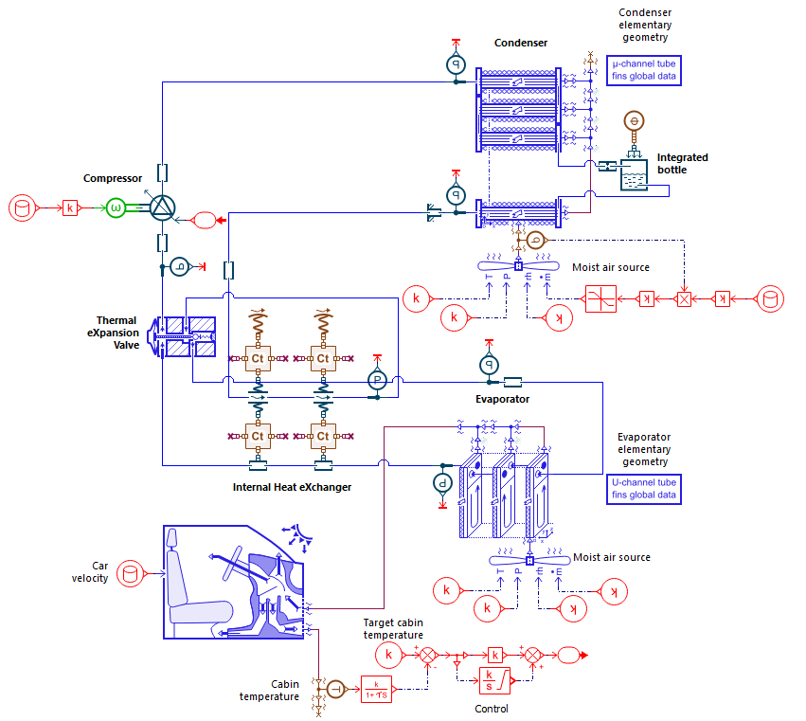
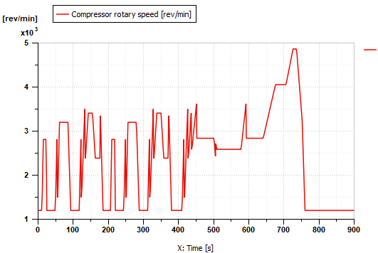
Thermal System Modeling: HVAC of a vehicle Cabin
Imposed drive cycle
Evolution of the compressor rotary speed

Slide 8
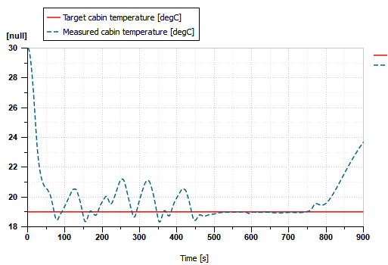
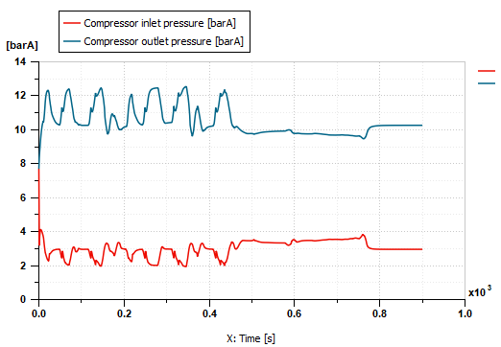
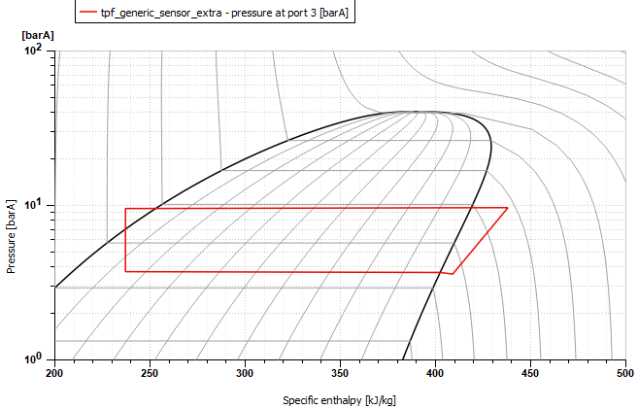
Evolution of the cabin temperature
Evolution of pressure at compressor inlet and outlet
Thermodynamic plot

Slide 9
1D Thermal Modeling for Thermal Management System

Slide 10
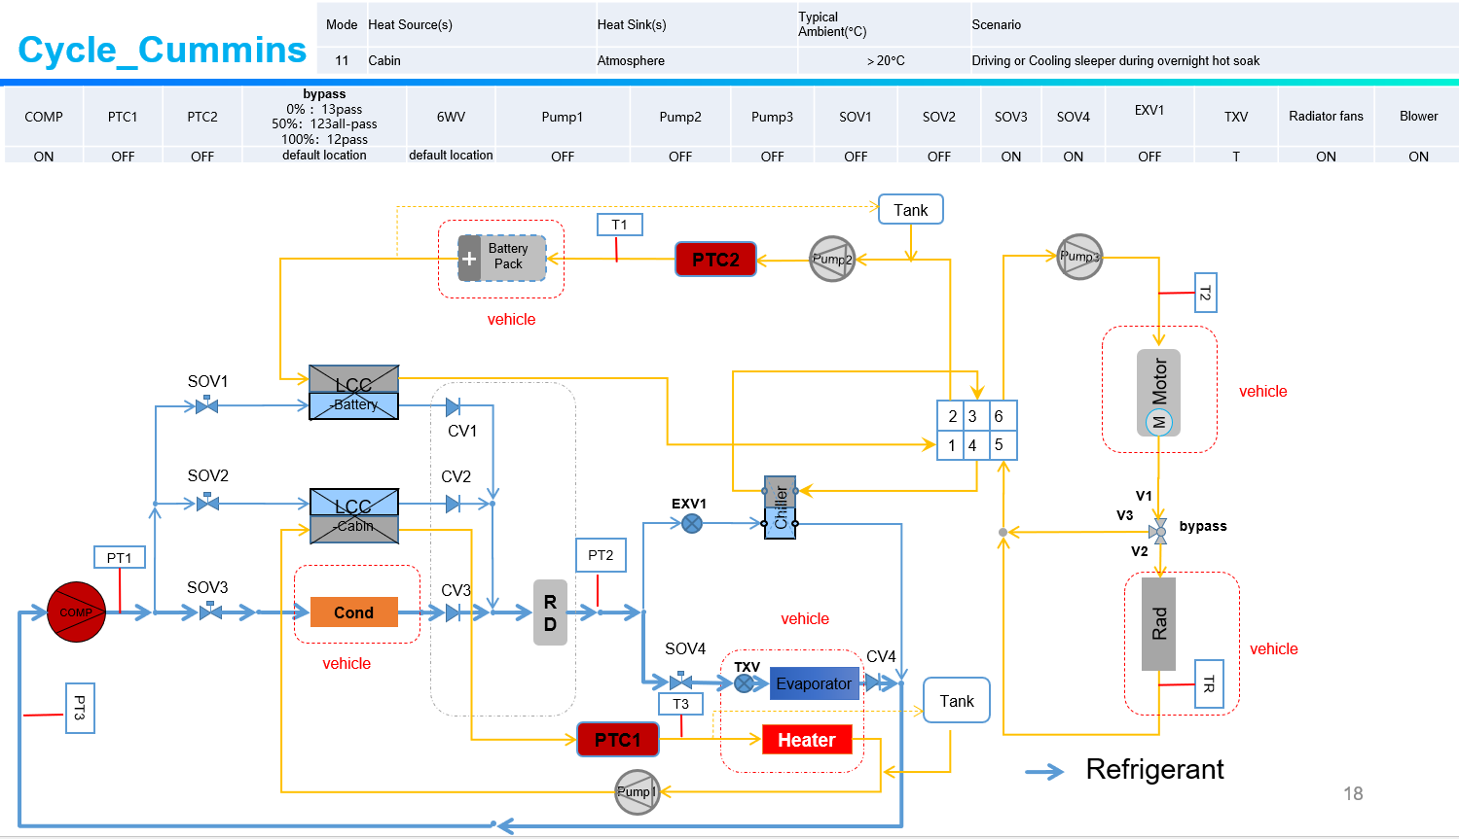
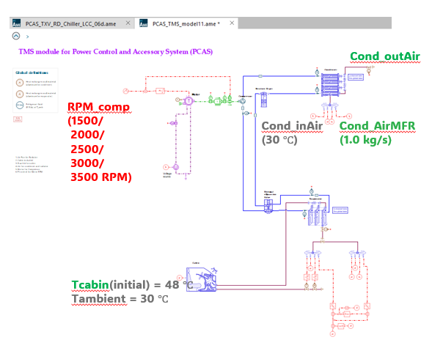
1D Thermal Modeling for Thermal Management System
System Diagram
Amesim Model

